Slide 1
Data structure of logic programming and reasoning

Slide 2
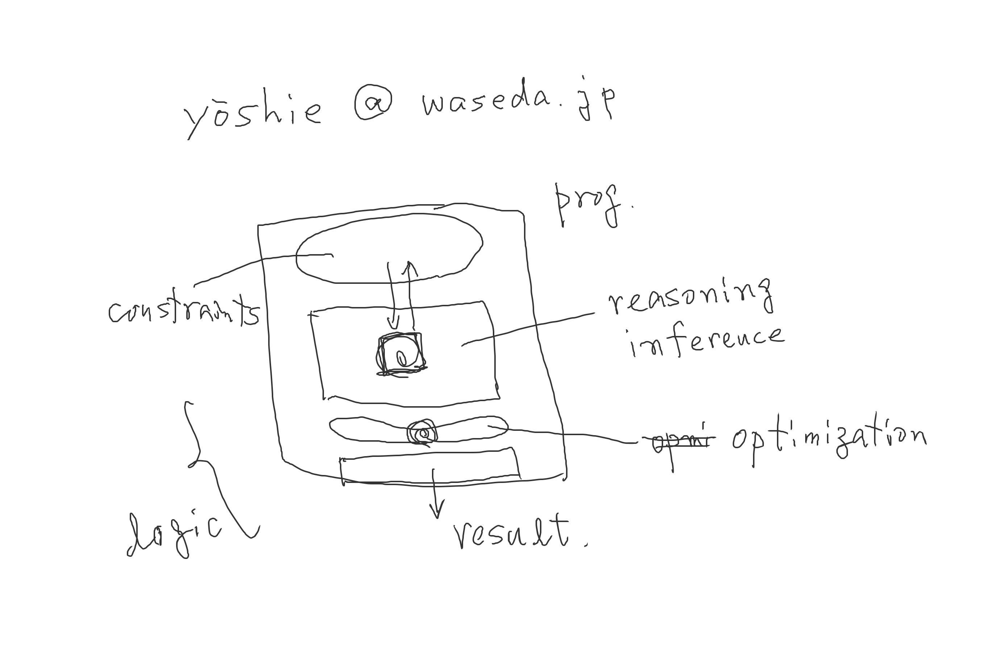

Slide 3
Previously on CPT(Constraint Processing Theory)
We use logic to build a model of the target problem.
There is a programming paradigm called “logic programming.”
Bprolog is our programming language.
Today we learn
What we do in Bprolog is having a session, which is comprised of question by the user and answer from Bprolog.

Slide 4
First-order predicate logic
argument
test.pl
father(kiyoshi, osamu).
father(takuji, kiyoshi).
father(kiyoshi, osamu).
father/2
predicate name
?- consult(‘test.pl’).
yes
father(yoshie, kiyoshi, osamu).
father/3

Slide 5
test.pl
father(kiyoshi, osamu).
father(takuji, kiyoshi).
If Bprolog can find a complete pattern matching between user’s question and a statement in the program, the answer is yes(true), otherwise no(false).
?- father(kiyoshi, osamu).
yes
?- father(taro, osamu).
no

Slide 6
test.pl
father(kiyoshi, osamu).
father(takuji, kiyoshi).
Variable:
its name begins with capital letter
or _
?- father(X, osamu).
X = kiyoshi
?- father(takuji, Child).
Child = kiyoshi
Who (X) is the father of ‘osamu’ ?
unification

Slide 7
test.pl
father(kiyoshi, osamu).
father(kiyoshi, kyoko).
Variable:
its name begins with capital letter
or _
?- father(kiyoshi, Son_or_daughter).
Son_or_daughter = osamu ;
backtracking

Slide 8
test.pl
father(kiyoshi, osamu).
father(kiyoshi, kyoko).
brother(X,Y) :-
father(F, X),
father(F, Y).
Facts and rules
father(kiyoshi, osamu). fact
Head :- body1, body2, … . rule
where ‘,’ means ‘and’.
?- brother(A,B).

Slide 9
test.pl
father(kiyoshi, osamu).
father(kiyoshi, kyoko).
brother(X,Y) :-
father(F, X), …△
father(F, Y). …▲
To prove brother (X, Y) is true,
prove △ and ▲.
P1 ⋀ P2 → Q (mathematics)
Q :- P1, P2 (Bprolog)
△father(F,X) ▲father(F,Y)
father(kiyoshi, osamu). F=kiyoshi
X=osamu Y=osamu
father(kiyoshi, kyoko). Y=kyoko

Slide 10
Previously on CPT(Constraint Processing Theory)
There are two types of predicate expression: fact and rule
Fact: predicate(arg1, arg2, …, arg n). Rule: head(args) :- body1(args), body2(args), …, bodym(args).
Pattern matching between your question and the facts & rules in the program is a fundamental mechanism. (test.pl)
Facts and rules can be regarded as the definition of new predicates.
Today we learn
Intrinsic predicates – member, append, is, =. (test3.pl)
Data structure “list”
Sendmoremoney program (sendmoremoney.pl)

Slide 11
SEND
+ MORE
MONEY

Slide 12
Intrinsic (built-in) predicates
system(‘DOS command’).
consult(‘program file’).
listing.
member(‘element’, ‘list’).
member(1, [1,2,3]). is true.
member(4, [1,2,3]). is false.
?- member(X, [1,2,3]). …what is the answer?
?- member(X,[1,2,3]), member(Y,[4,5]). …what is the answer?

Slide 13
test2.pl
family_yoshie([takuji, kiyoshi, osamu, kyoko]).
?- family_yoshie(Family), member(P, Family).

Slide 14
test3.pl
domain_of_X([-2,-1,0,1,2]).
domain_of_Y([-2,-1,0,1,2, 100,101,102]).
solve_equation(X,Y) :-
domain_of_X(Dx), domain_of_Y(Dy),
member(X,Dx), member(Y,Dy),
Z is X+Y, Z == 0.
?- solve_equation(X,Y).

Slide 15
Previously on CPT
Built-in predicates : we can use without defining them member, append, is, =. (test3.pl)
Data structure “list”
Reasoning(search) by Bprolog is depth-first.
Today we do
Intrinsic predicates –Data structure “list”
Recursion
exercise

Slide 16
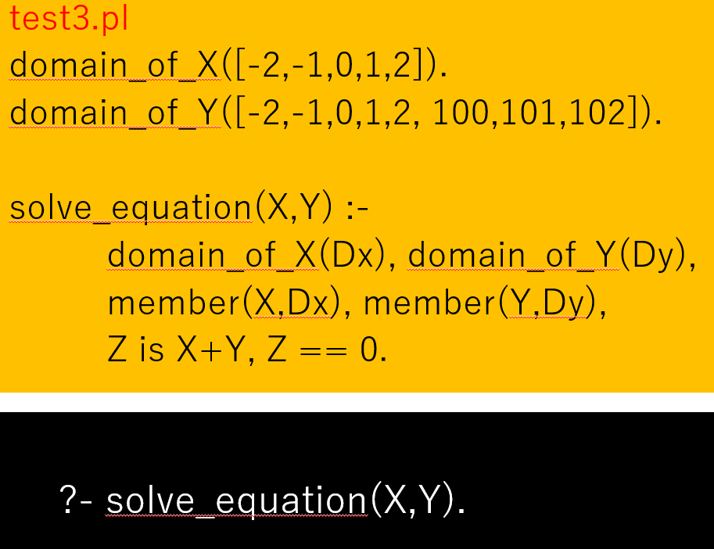
Reasoning(search) in Bprolog is depth-first.
member(X, [-2, -1, 0, 1, 2])
member(Y, [-2, -1, 0, 1, 2, 100, 101, 102])
X = -2
X = -1
X = 0
Y = -2
Y = -1
Y = 0
Y = …

Slide 17
Send more money puzzle
SEND
+
MORE
=
MONEY
?- factorial(2, X).

Slide 18
Factorial of n:
n! = n(n-1)(n-2)…1
Factorial of 3 = 3*2*1=6
Factorial of 0 = 1 (0!=1)
-----
Factorial of n = n*Factorial(n-1)
-----
factorial(N, Result) :- N1 is N-1, factorial(N1, A), Result is A*N.
Recursion : coming back to itself, defining using itself.

Slide 19
Factorial of n:
n! = n(n-1)(n-2)…1
---
Factorial of n = n*Factorial(n-1)
---
factorial(N, Result) :- N1 is N-1, factorial(N1, A), Result is A*N.
Recursion : coming back to itself, defining using itself.
factorial(0,1). % sentinel
factorial(N, Result):-
N1 is N-1,
factorial(N1, A),
Result is A*N.
?- factorial(2, X).
?- factorial(1, X’).
?- factorial(0, X’’).

Slide 20
Usage of data structure “list”
An example of list: [1,2,3,4,5]
[A,B,C] = [1,2,3] <= true
[A,B,C] = [1,2] <= false
[H | Rest] = [1,2,3,4,5,6,7,8,9] <= H=1, Rest=[2,3,4,5,6,7,8,9]
[H1,H2| Rest] = [1,2,3,4,5,6,7,8,9] <= H1=1, H2=2, Rest=[3,…,9]
append(List1, List2, List23)
member(Element, List)

Slide 21
Constraint Satisfaction Problem(CSP)
Previously on CPT
CSP = {variables, domains, constraints}
Example of arithmetic CSP D(X) = {1,2,3}, D(Y) = {1,2} <= member(X, [1,2,3]) member(Y, [1,2]) set of (primitive) constraints: C={X+Y>4, X-Y=1} satisfiable, unsatisfiable, unknow ? <= constraint solver

Slide 22
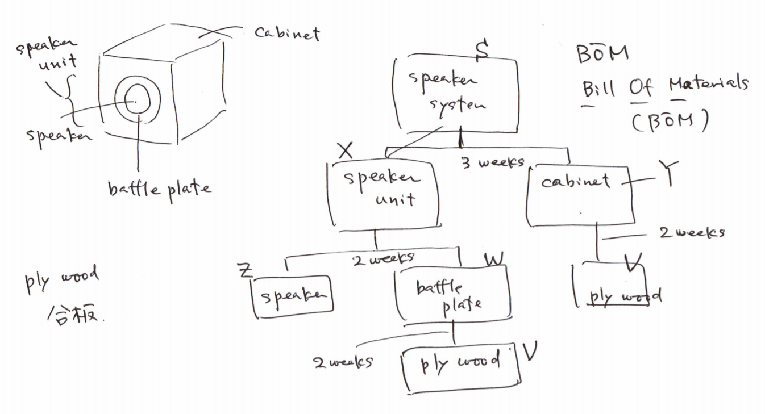
Scheduling

Slide 23
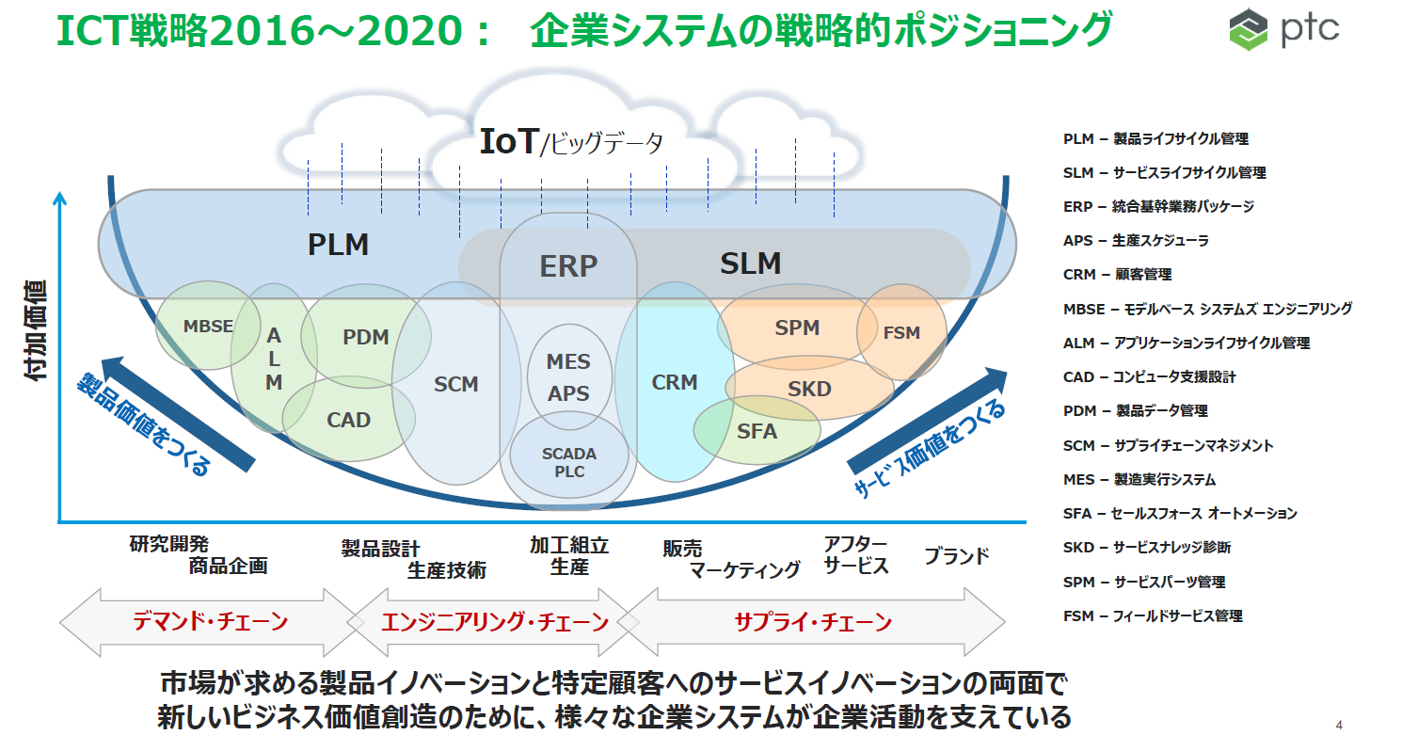

Slide 24

BOM – fundamental data structure in PLM

Slide 25
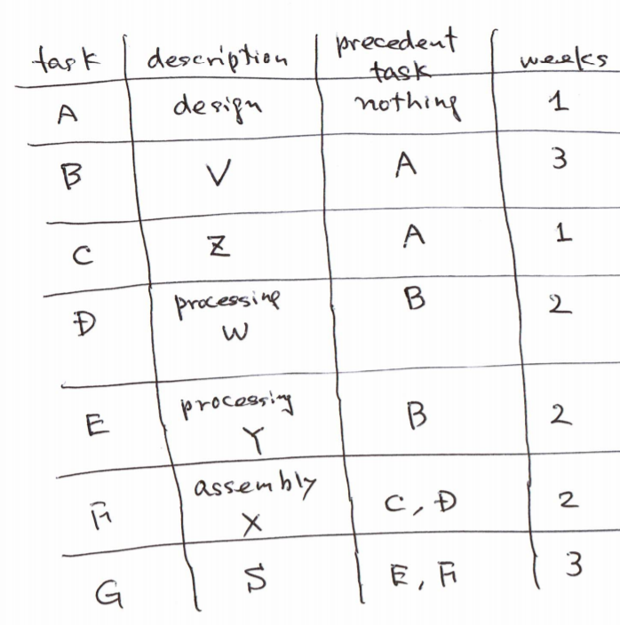
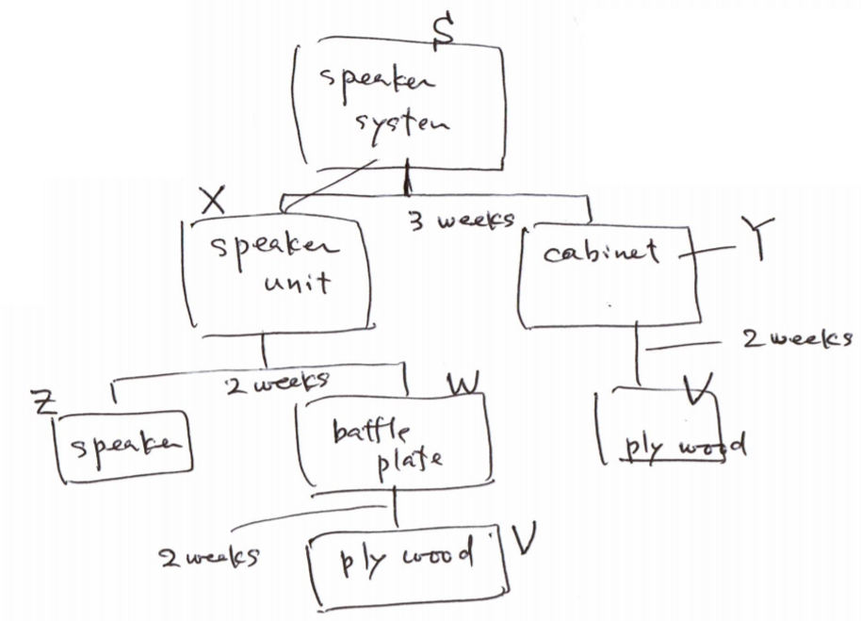
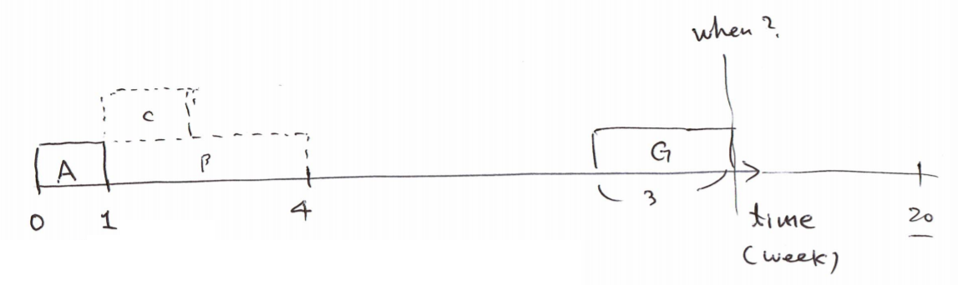
Delivery(finishing) date reply

Slide 26
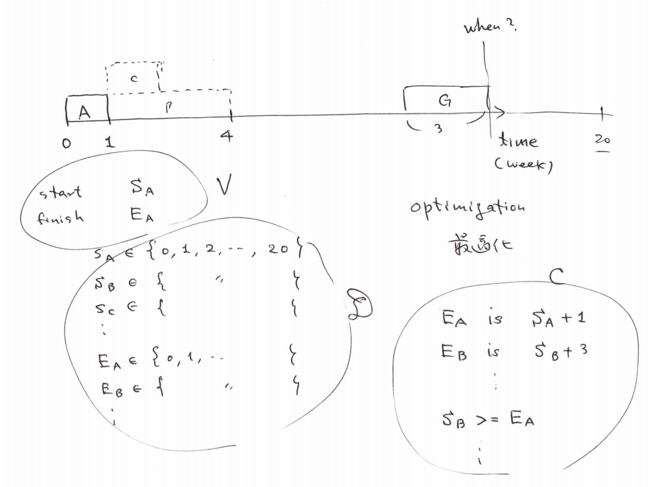
Modeling as a Constraint Satisfaction Problem

Slide 27
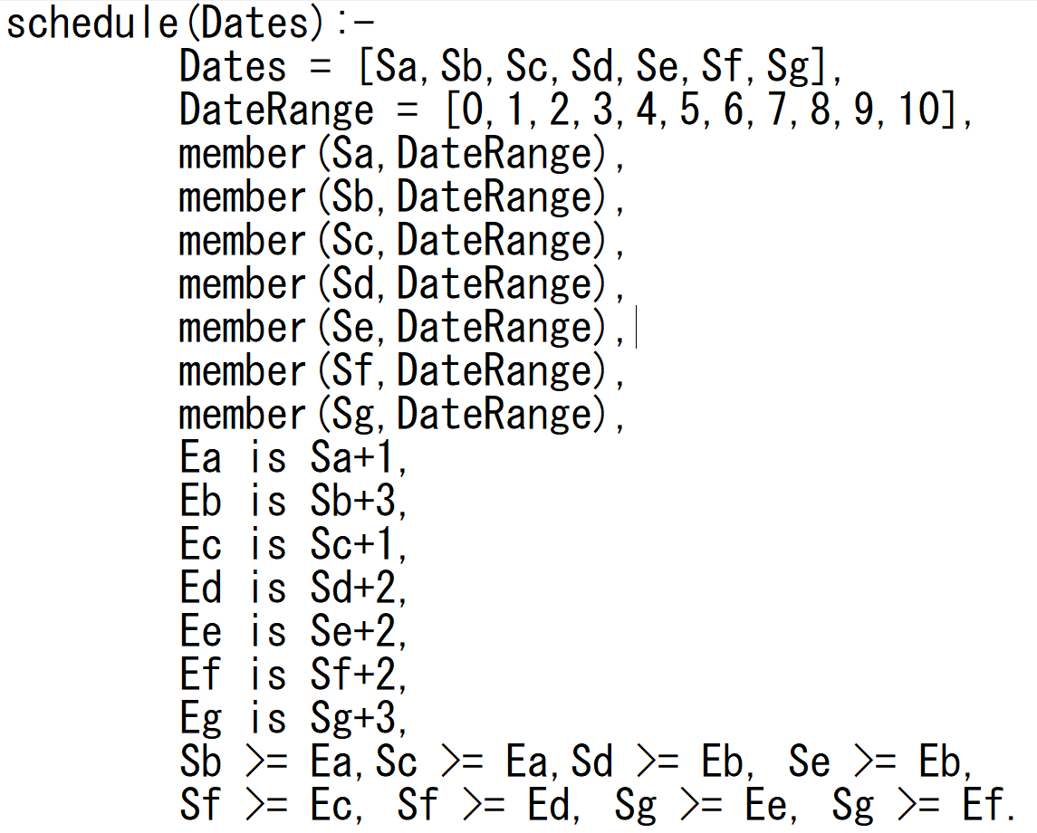
Programming in Bprolog

Slide 28
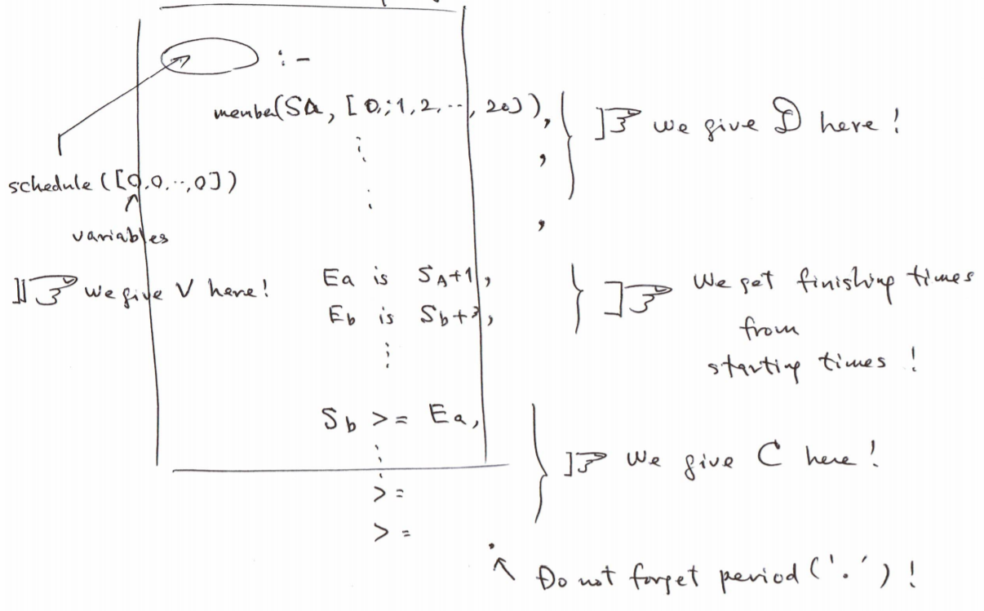
Structure of the program

Slide 29
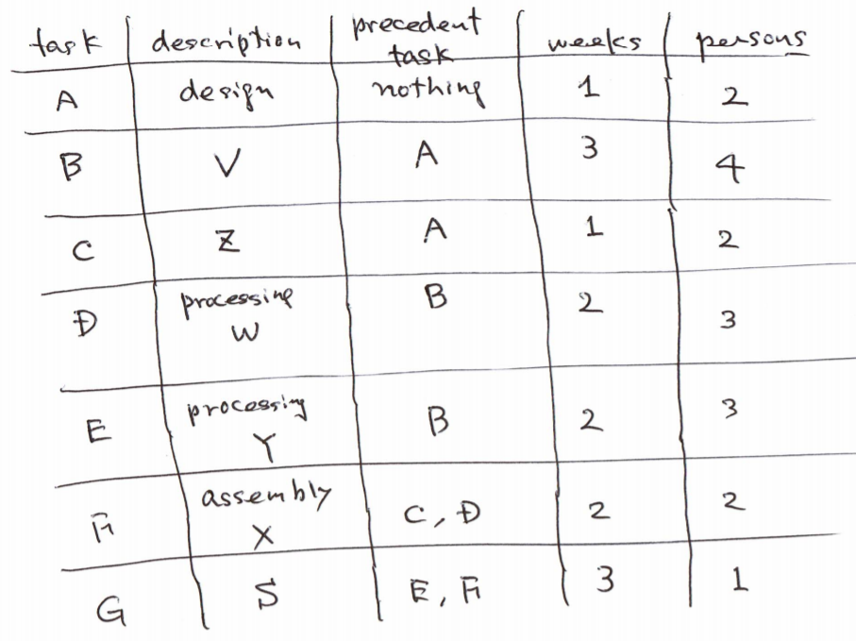
Another constraint comes...

Slide 30
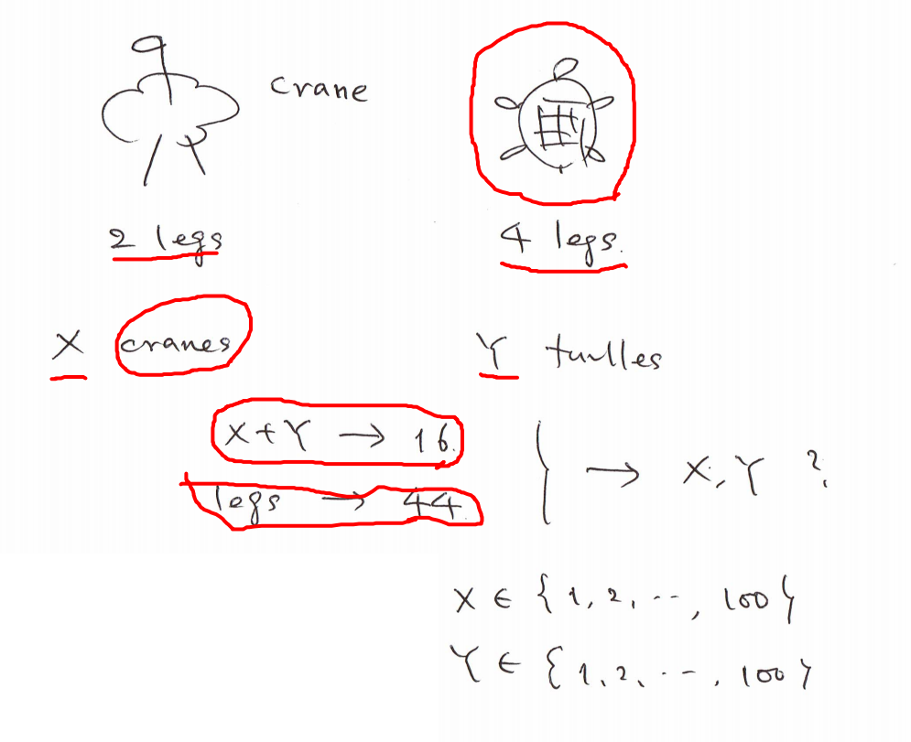
Domain simplification is a key idea

Slide 31
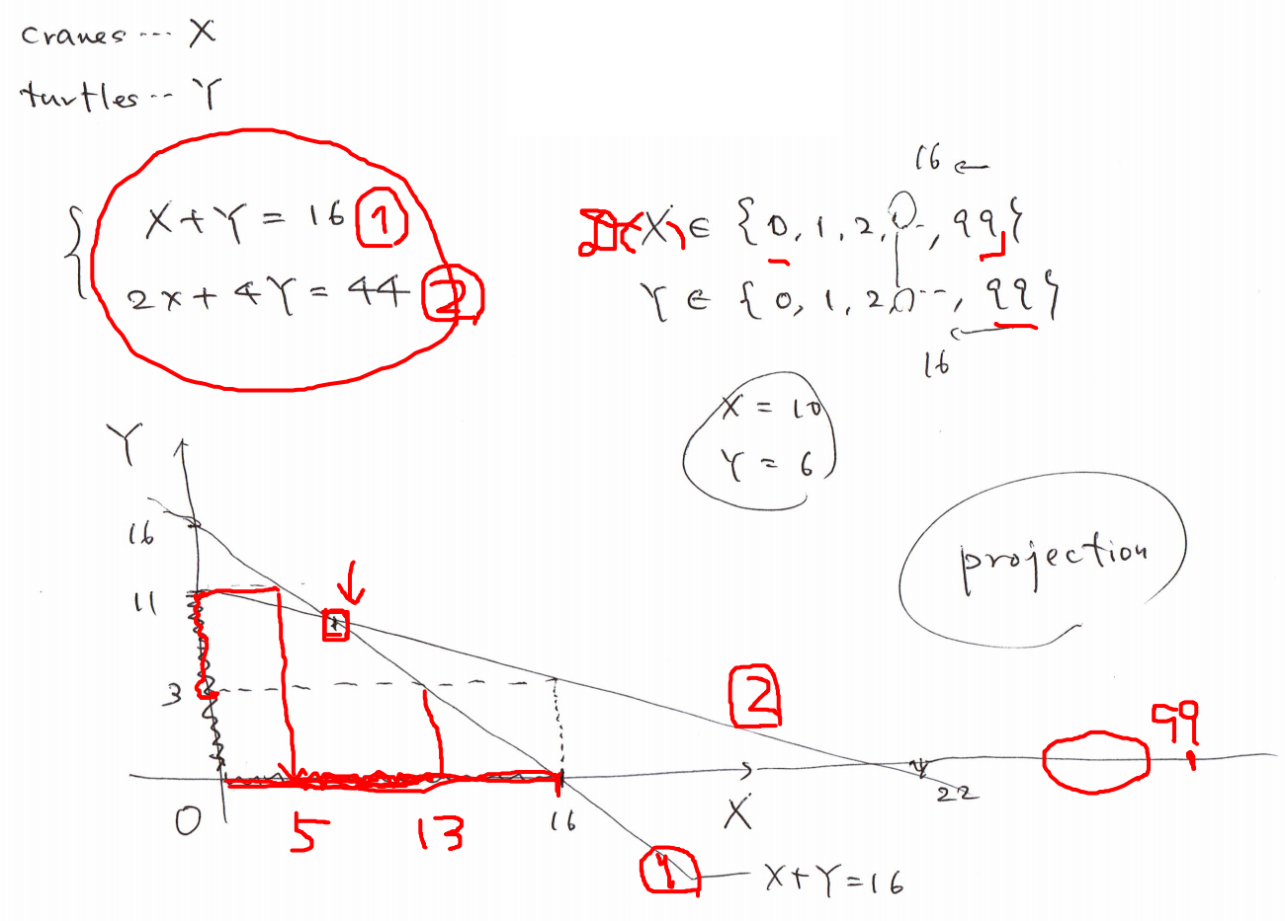
Domain simplification is a key idea

Slide 32
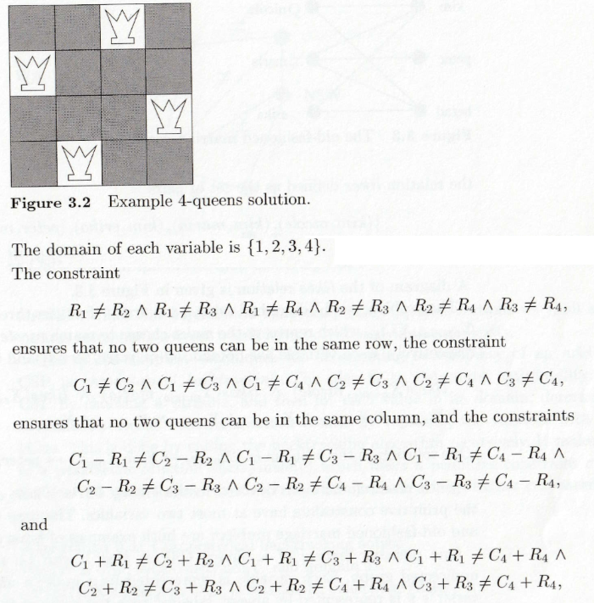
4 Queen puzzle
Queen i has two
variables: (Ri, Ci)
?- factorial(2, X).

Slide 33
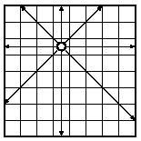
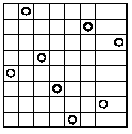
8 Queen puzzle
If Queens’ positions in columns 1-7 are fixed,
then the position in column 8 can be found.
?- factorial(2, X).

Slide 34
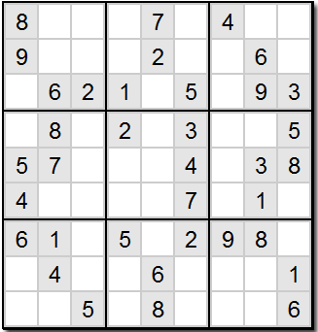
Sudoku puzzle
?- factorial(2, X).

